Slide 1

Internship Project Presentation
Saptarshi De Chaudhury | Product Engineering Intern
© 2023 Sprinklr, Inc. CONFIDENTIAL - INTERNAL ONLY. All rights reserved.

Slide 2
Problem Statement
In real life systems, we often encounter a large number of write/update requests generated by different services, to the primary database being shared across all the entities.
Requests may come as a sudden spike. We can decouple the consumer and producer by introducing a buffer database/queue. This protects read-optimised databases from such spikes.
Objective – Build a system to simulate the above situation.
Producer component produces large number of requests.
Consumer component consumes requests and indexes data into ElasticSearch.
Analyse performance of the system and time taken using different types of buffers, as well as different batch sizes.
© 2023 Sprinklr, Inc. CONFIDENTIAL - INTERNAL ONLY. All rights reserved.

Slide 3
Solution Overview

Slide 4
Producer Component
Creates documents in batches and sends write request to the buffer for storage of the batch.
Two types of buffer used: MongoDB and Apache Kafka.
Producer changes its rate of production at regular intervals (5 seconds), to simulate varying request traffic.
Utilized scheduling in Spring, to keep the producer running and change its rate at regular intervals.
Spikes introduced in the producer by way of increased frequency of scheduling.
Computes the number of batches created in each interval, and the time taken to create each batch.
© 2023 Sprinklr, Inc. CONFIDENTIAL - INTERNAL ONLY. All rights reserved.

Slide 5
Consumer Component
Removes a batch of documents from the buffer.
Extracts individual documents from the batch and sends a bulk indexing request to ElasticSearch index.
Consumer scheduled to run for some time (20 seconds) and then sleep for 10 seconds, before waking up again. This allows documents to be accumulated in the buffer.
Computes the total time taken for each batch from creation to indexing in ElasticSearch. Also computes time taken to extract each batch from the buffer and process it.
© 2023 Sprinklr, Inc. CONFIDENTIAL - INTERNAL ONLY. All rights reserved.

Slide 6
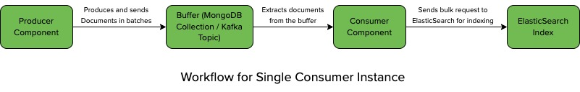
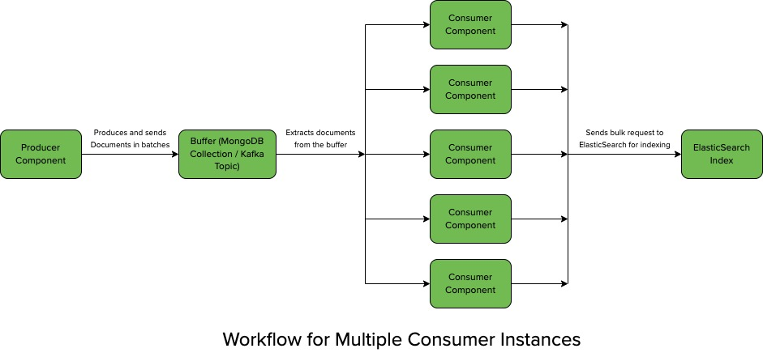
Workflow Diagram
© 2023 Sprinklr, Inc. CONFIDENTIAL - INTERNAL ONLY. All rights reserved.

Slide 7
Performance Analysis
© 2023 Sprinklr, Inc. CONFIDENTIAL - INTERNAL ONLY. All rights reserved.

Slide 8
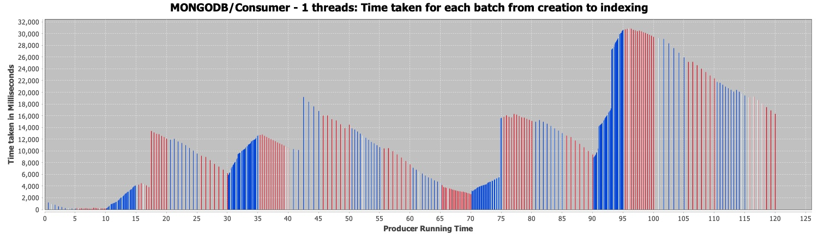
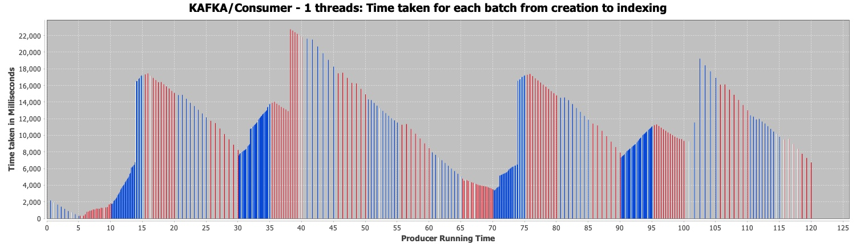
Single Consumer Instance
Batch Size: 2000 docs
Batch Size: 2000 docs
© 2023 Sprinklr, Inc. CONFIDENTIAL - INTERNAL ONLY. All rights reserved.

Slide 9
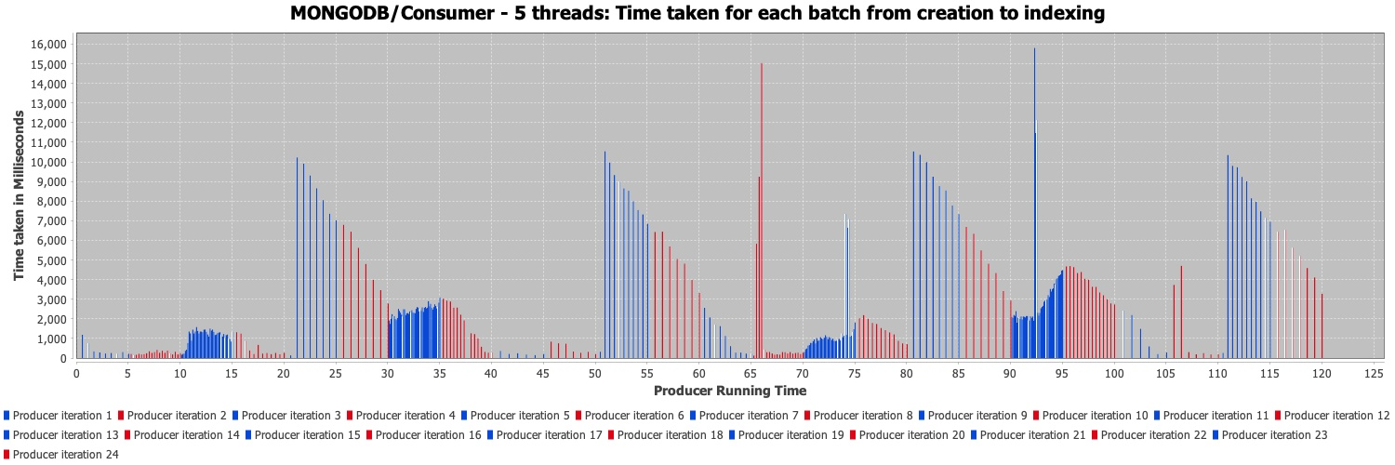
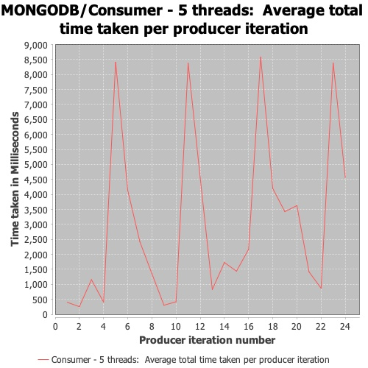
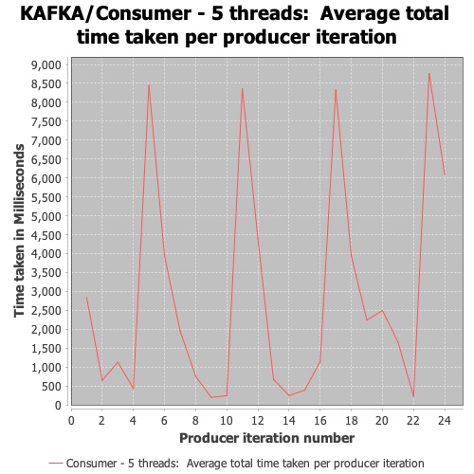
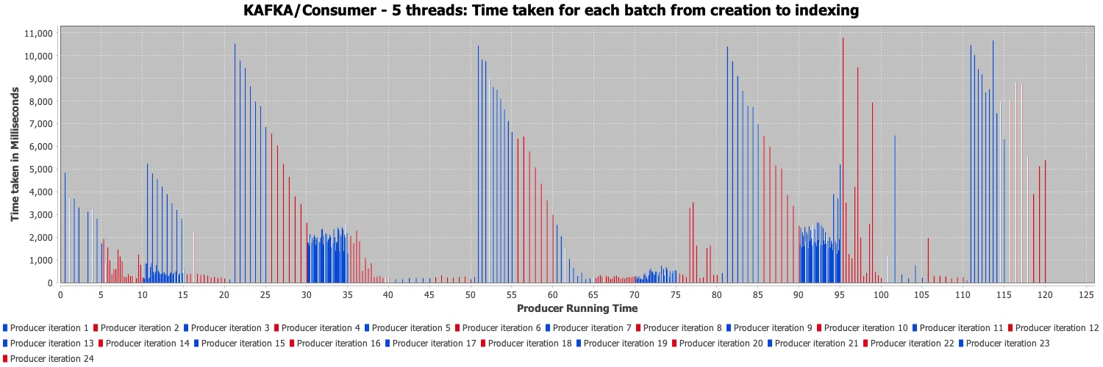
Multiple Consumer Instances (Batch Size - 2000 documents)
Batch Size: 2000 docs
Batch Size: 2000 docs
© 2023 Sprinklr, Inc. CONFIDENTIAL - INTERNAL ONLY. All rights reserved.

Slide 10
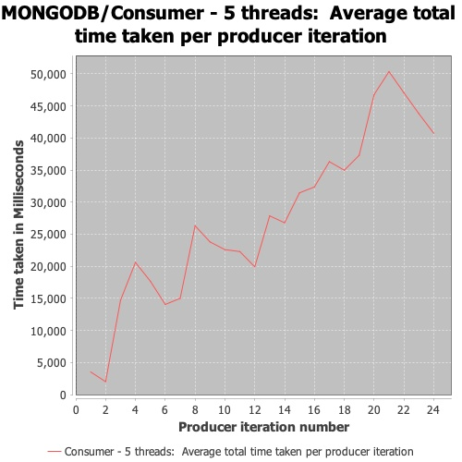
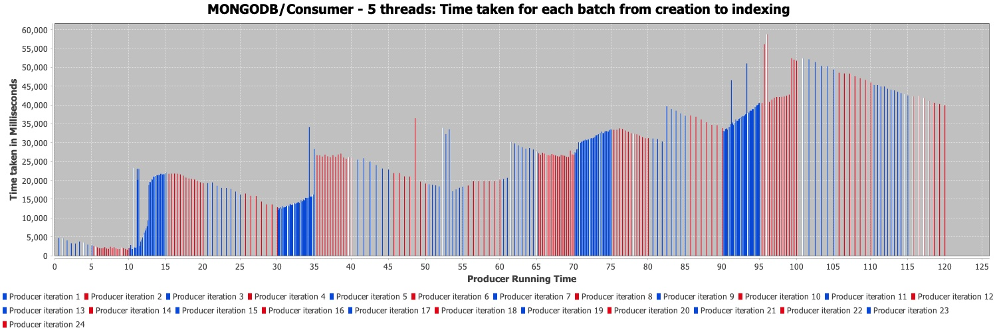
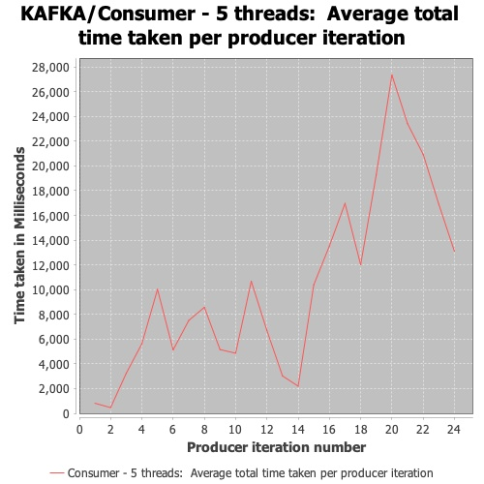
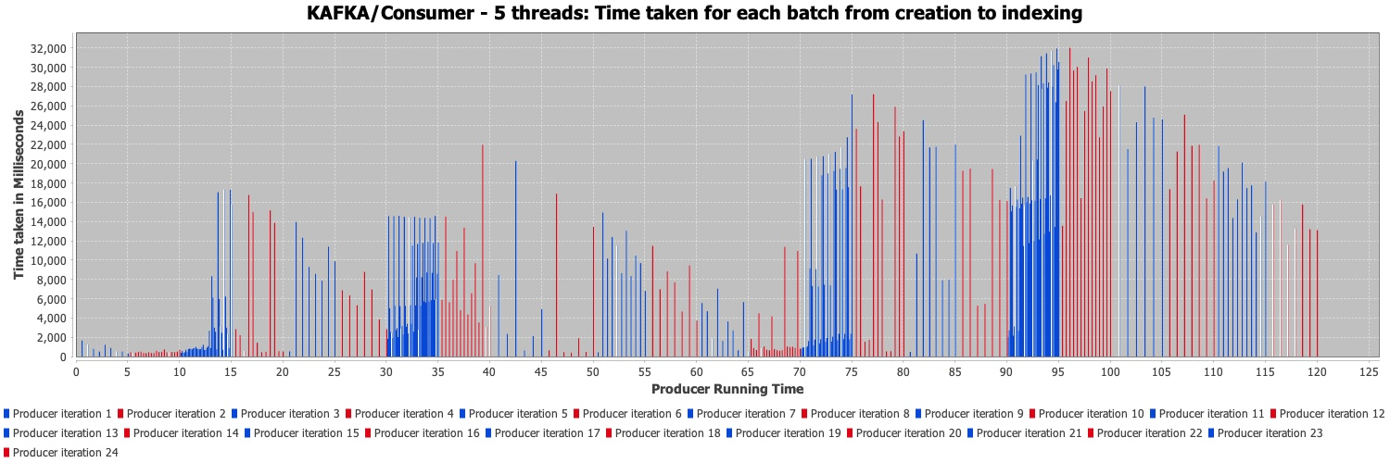
Multiple Consumer Instances (Batch Size - 5000 documents)
Batch Size: 5000 docs
Batch Size: 5000 docs
© 2023 Sprinklr, Inc. CONFIDENTIAL - INTERNAL ONLY. All rights reserved.

Slide 11
Observations
Single Consumer
The consumer consumes the batches from the buffer, in the order of their insertion.
The downward slope of the graph indicates that the consumer clears the buffer faster than the producer fills it up.
The upward slope occurs in the graph, when there is a spike in producer requests. Hence the consumer takes longer time to clear the buffer.
Using Kafka as buffer, we get better performance than MongoDB i.e., it takes less time overall from creation to indexing.
Multiple Consumers
In MongoDB, we use a lock on the buffer to ensure that no two threads consume the same batch. Whereas in Kafka, each consumer thread consumes from a separate partition of the Kafka topic, so there is no race condition.
In Kafka each thread is independently consuming from separate partitions, so the order of consuming batches is not necessarily same as the order of insertion.
Using multiple threads, we get better performance overall using both Kafka and MongoDB, compared to single threaded consumer.
© 2023 Sprinklr, Inc. CONFIDENTIAL - INTERNAL ONLY. All rights reserved.

Slide 12
Thank you
saptarshi.dechaudhury@sprinklr.com
sprinklr.com

